Slide 1
Introduction to Single Cell Sequencing Technology
Theory

Slide 2
Course Introduction
Overview
This course is an introduction to the field of single-cell RNA sequencing. It encompass a range of softwares and analytical workflows, from best practices for filtering scRNA-seq data to downstream analysis for cell clustering and temporal sequencing. This course will help participants obtain accurate insights in the pre-processing, analysis and interpretation of scRNA-seq data.
The course begins with an introduction to general concepts about single-cell RNA sequencing. From there, we will go on to describe the major analytical steps from raw sequencing data to processed and usable data. We will introduce classical analytical workflows, their output and possible pathways for downstream analysis.
In the whole course we focus on the R/Bioconductor ecosystem and the different software packages that will be used to analyze the datasets and learn new methods
Course Schedule
The course is delivered in modules over three days. During the first 1/3 of each day, formal lectures will cover the key concepts needed to understand the principles of scRNA-seq analysis (approximately 2 hours).
After these lectures, practical examples will be shown to illustrate how to translate the knowledge gained into functional R codes (~1 hour). During this phase, participants will become familiar with state-of-the-art scRNAseq analysis packages, as well as bioinformatics best practices. In the second half of the day (3 hours), participants will work on their own, following guided exercises to improve their understanding of scRNAseq analysis workflow.
Tips and solutions will be provided for each exercise. The exercises will focus primarily on the specific concepts introduced earlier in the day. However, the analysis steps learned in the previous days will also be integrated so that by the end of the week, participants are fully capable of performing basic scRNAseq analysis from start to finish.
Office hours will take place during the last hour of the exercise. The instructor will answer individual questions related to the daily exercises. the Slack channel will also be available so that everyone can get a Q&A.
Learning outcomes
By the end of this course, you should be able to understand 1) the advantages/disadvantages of different single-cell RNA-seq methods, 2) scRNA-seq data processing and quality control normalization, 3) scRNA-seq data batch effect elimination, 4) results visualization, 5) and apply dimensionality reduction techniques for cell clustering and annotation for differential gene expression analysis to infer cell trajectories and pseudo-times.

Slide 3
1. Types of single-cell sequencing (modality)
scDNA-seq
scRNA-seq
scMethy-seq

Slide 4
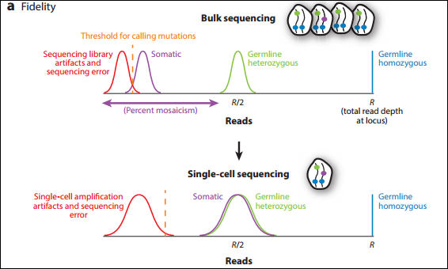
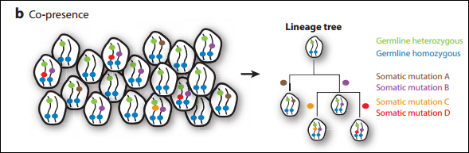
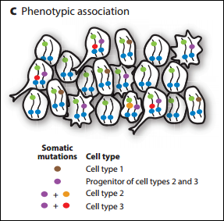
scDNA-seq
a) Fidelity. In bulk sequencing, low-frequency mutations cannot be distinguished from sequencing libraries and sequencing error artifacts. In contrast, in single-cell sequencing, the distribution of sequencing depth is the same for somatic mutations and germline (genetic) heterozygous mutations (e.g. a given SNV has a mutation rate of 0.1% in bulkDNA sequencing, but in a single cell, that SNV may have a mutation rate of 50% or 100%, because for a single cell there are only two states for each SNV: heterozygous or pure and).
b) Co-occurrence. Single-cell sequencing preserves information about which somatic mutations are present in the same cell at the same time. This allows the reconstruction of genealogical trees.
c) Phenotypic association. Single-cell sequencing, when combined with concurrent cell phenotyping (by microscopy or multiple single-cell sequencing), preserves information about which somatic mutations are present in which cell types, which enables deconvolution of cell types or species in heterogeneous samples and annotation of genealogical trees with cell phenotypes.
Notes:
2021-Applications of Single-Cell DNA sequencing

Slide 5
scDNA-seq
The data analysis method does not differ much from bulk sequencing, mainly in the experimental library construction.
Missionbio's technology (https://missionbio.com/company/blog/single-cell-dna-vs-got/)
1. Nam AS et al. Somatic mutations and cell identity linked by Genotyping of Transcriptomes. nature. 2019. jul;571(7765):355-360.
2. Miles LA et al. Single-cell mutation analysis of clonal evolution in myeloid malignancies. nature. 2020 Nov;587(7834):477-482.
3. Peretz CAC. Single-cell DNA sequencing reveals complex mechanisms of resistance to quizartinib. Blood Adv. 2021 Mar 9;5(5):1437-1441.
4. Dillon LW et al. Personalized Single-Cell Proteogenomics to Distinguish Acute Myeloid Leukemia from Non-Malignant Clonal Hematopoiesis. Blood Cancer Discov. 2021 Jul;2(4):319-325.

Slide 6
scRNA-seq
RNA-seq allows the analysis of transcripts in samples in an efficient and cost-effective way. It is a major breakthrough in the last 20 years and has largely replaced other transcriptome analysis techniques, such as microarray technology. Part of the reason for its success is that RNA-seq allows unbiased sampling of all transcripts in a sample, rather than being limited to a predefined set of transcripts (e.g., microarray or RT-qPCR).
Typically, RNA-seq is used for samples consisting of a mixture of cells, known as bulk RNA-seq, and is most often applied when quantifying gene expression. It can also be used to find and annotate novel genes, gene isoforms and other transcripts.
bulk RNA-seq can only estimate the average expression level of each gene in a population of cells and cannot determine the heterogeneity of gene expression in individual cells in that sample. Therefore, it is not sufficient to study heterogeneous systems such as early developmental studies or complex tissues such as the brain.
Heralded the emergence of single-cell technology. The application of RNA-seq (scRNA-seq) at the single-cell level, which was first published in 2009 (Tang et al., 2009). However, it has only become more popular since 2014, accompanied by new protocols (strategies) and lower sequencing costs. Unlike bulk RNA-seq, with scRNA-seq we can estimate the distribution of expression levels of each gene in the cell population.
This technology can address novel biological questions in which cell-specific changes in the transcriptome are important. Examples include the discovery of new or rare cell types, the identification of different cellular compositions between healthy/diseased tissues, or the understanding of cellular differentiation during development. One of the most representative uses of this technology is the creation of genetic profiles, which provide a comprehensive compilation of cellular diversity within an organism and have many applications in health and basic research.

Slide 7
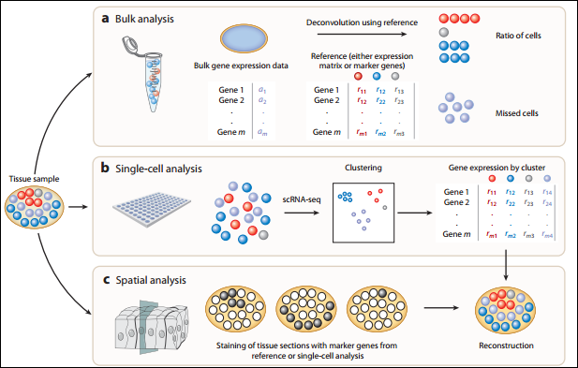

Slide 8
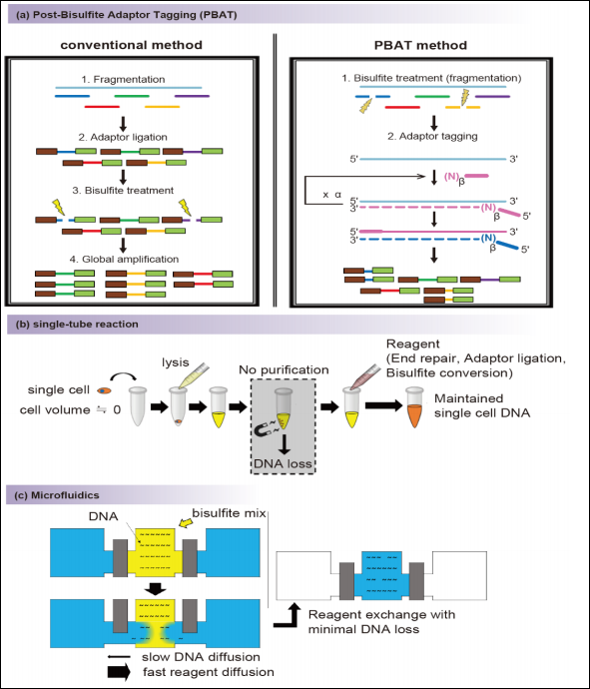
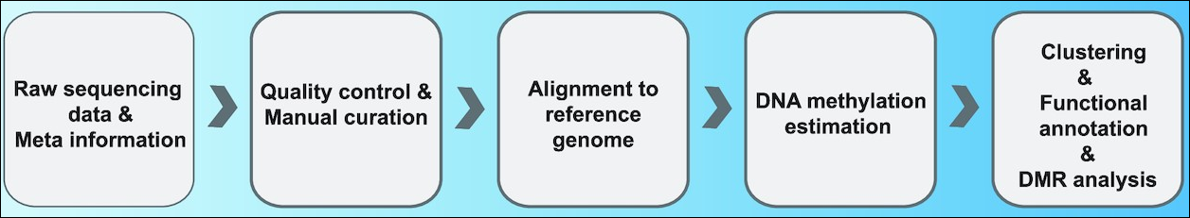
scMethy-seq
The pipeline of single cell methylation data analysis is not different from the bulk methylation data analysis, and the key is to minimize DNA loss when obtaining genomic DNA and DNA after BS-transformation.

Slide 9
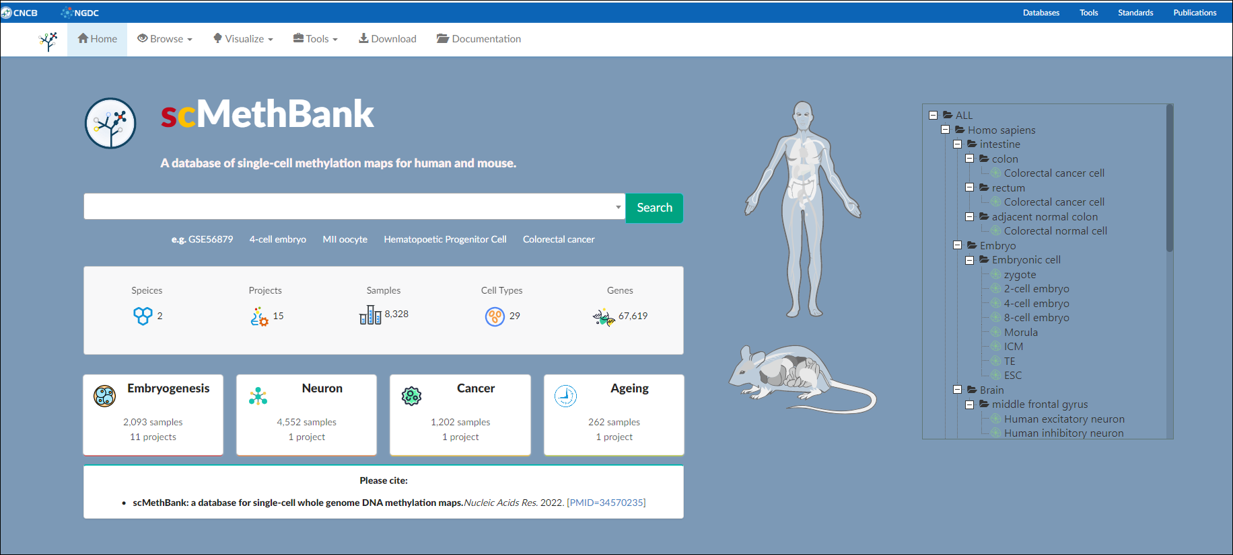
scMethy-seq
https://ngdc.cncb.ac.cn/methbank/scm/

Slide 10
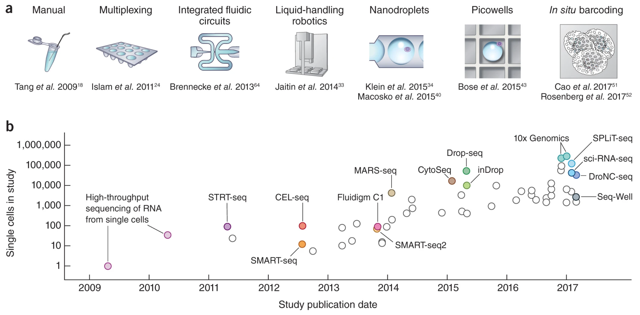
2. The development history of scRNA-seq technology
The scRNA-seq datasets range from a few hundred cells per study to millions of cells, and are increasing every year. There are several different protocols available, both commercially available and publicly freely available, each with its own advantages and disadvantages (described in detail later).
Moore's Law of single-cell transcriptomics, showing that the amount of data from experiments has increased from a few dozen cells to millions of cells in just over a decade
Notes:
Moore's Law of single-cell transcriptomics, showing an increase in experimental throughput from tens of cells to millions of cells in just over a decade

Slide 11
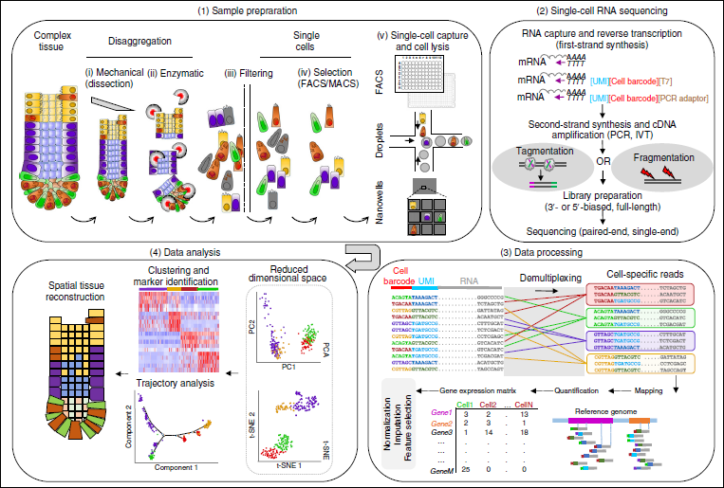
3. General steps of scRNA-seq experiment
scRNA-seq usually consists of the following steps
Acquisition of single cells
Library preparation and Sequencing
Gene expression profiling acquisition
Downstream analysis (focus)

Slide 12
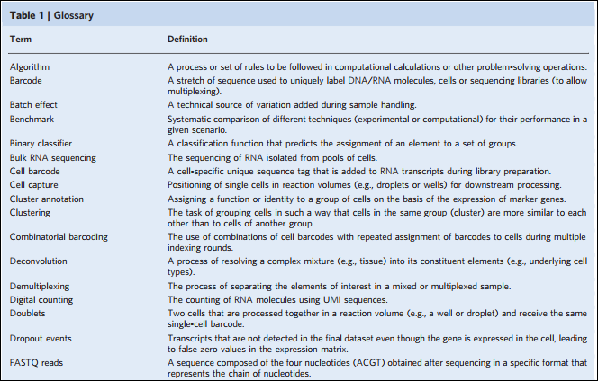
4. Basic concepts

Slide 13
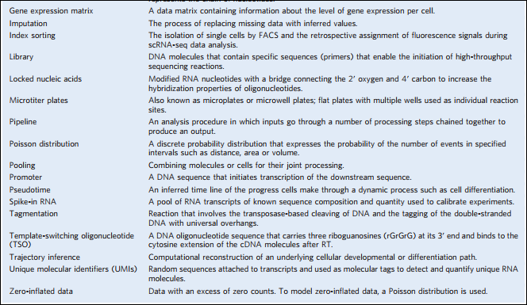

Slide 14
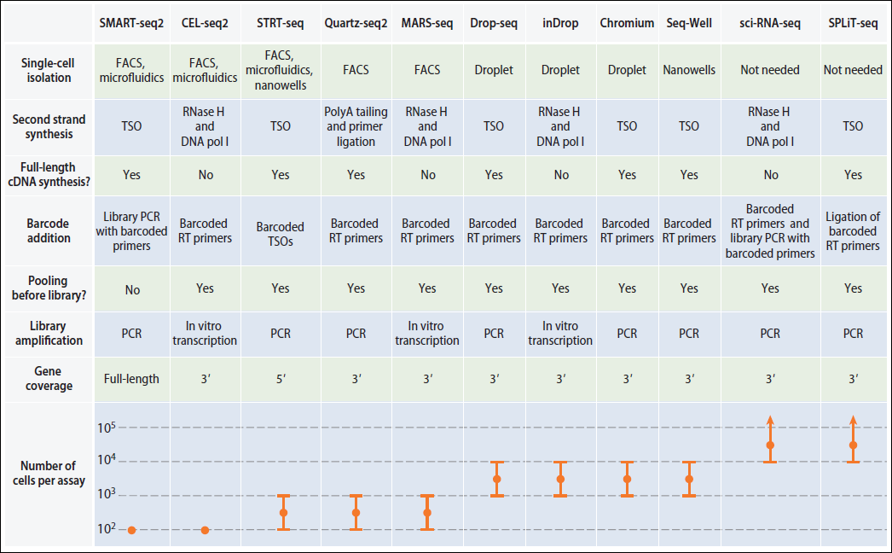
5. Common scRNA-seq technology platforms
Currently, there are a variety of protocols for preparing scRNA-seq data, but the two most important differences are cell capture or isolation and transcript quantification.

Slide 15
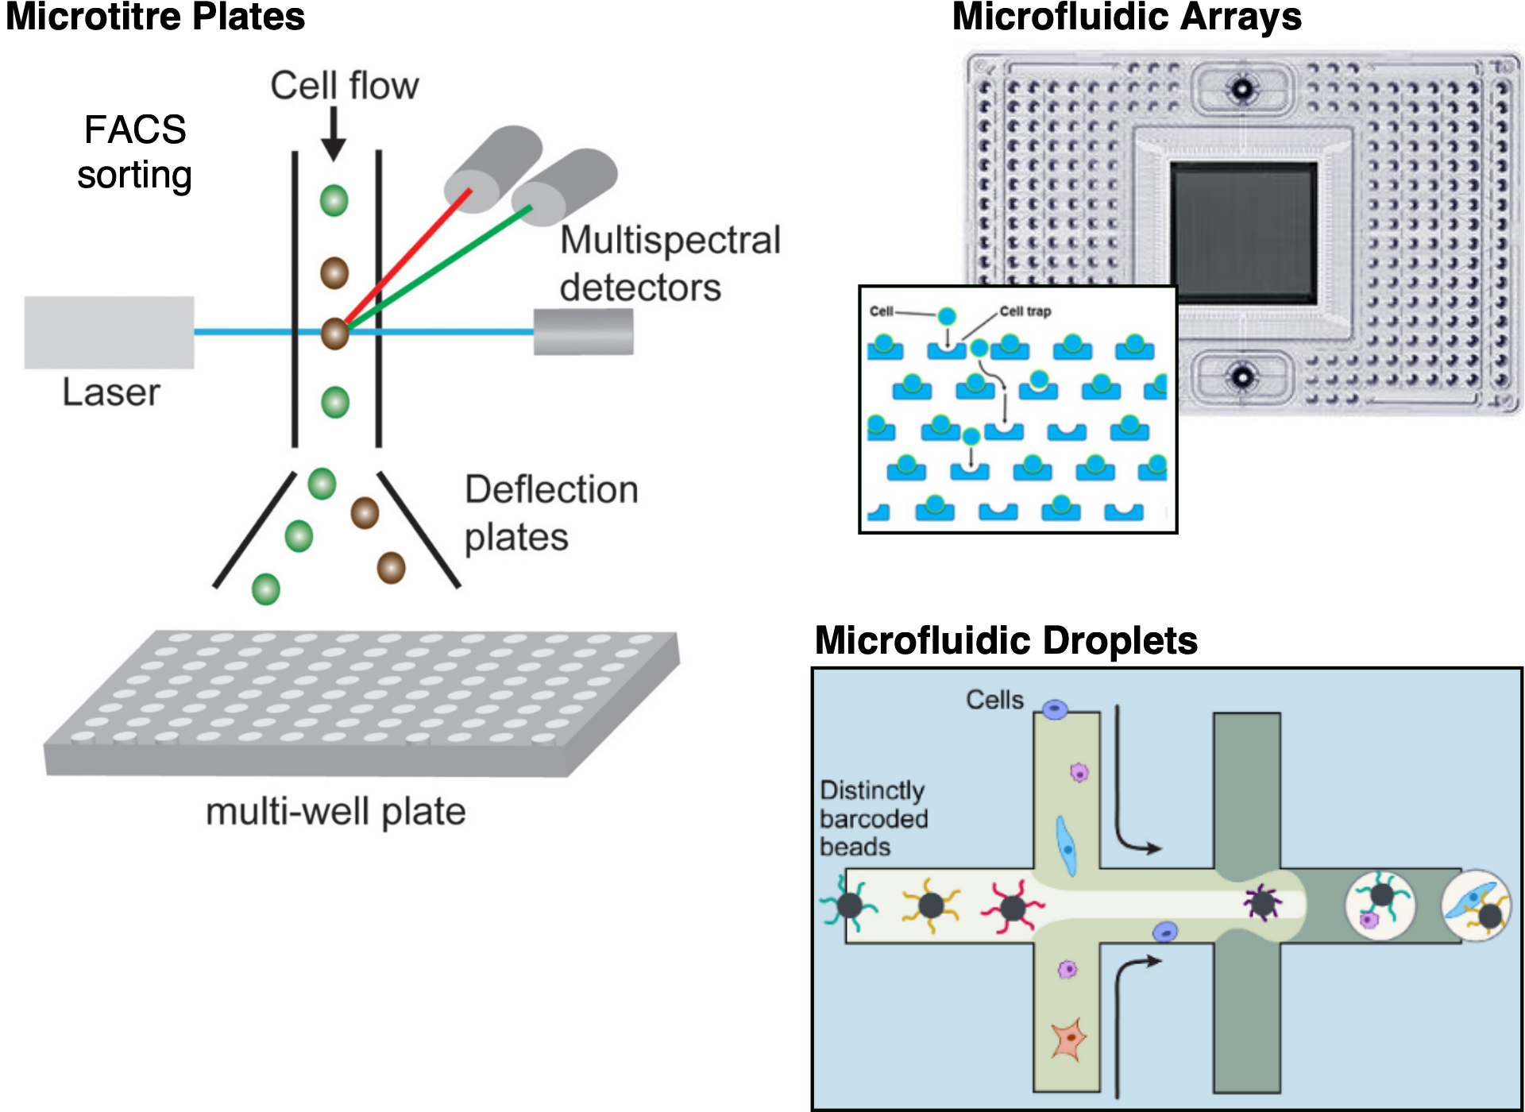
5.1 Cell capture
The strategy for capturing single cells determines the throughput of the technique, and there are three most widely used methods.
Microtitre plates: Relies on the separation of cells into individual wells of the plate using methods such as pipetting, microdissection or fluorescence-activated cell sorting (FACS).
The advantage is that we can take pictures of the cells before preparing the library, providing additional patterns of data. For example, damaged cells can be identified and discarded, or wells containing twins (wells with two or more cells) can be found.
When using automated FACS sorting, information such as cell size and the intensity of any label used can also be linked to the coordinates of the wells and thus to the individual cell indices in downstream analysis.
The main disadvantage is the low throughput and the large amount of work required per cell.
Microfluidic array: such as Fluidigm's C1, providing a more complete system for capturing cells and performing the reactions required for library preparation.
provided higher yields than the microtiter plate based method.
Typically, microfluidic platforms can only capture about 10% of cells and are not suitable for handling rare cell types or very small amounts of input.
There are limitations on the size of cells captured, as the nanopores are customized for specific sizes (which may affect unbiased sampling of cells in complex tissues). In addition, the chip is relatively expensive and
The reaction can be carried out in a smaller volume, which can save the cost of reagents.
Microfluidic droplet: the highest throughput and is currently the most popular method.
Individual cells are encapsulated with a bead in a nanoliter-sized oil droplet. The bead contains the enzyme and other components needed to construct the library.
Each bead contains a unique barcode that is attached to all sequencing reads from that cell. All droplets can be put together for sequencing and reads can then be assigned to the cell of origin based on these barcodes.
Library preparation costs for the droplet platform are relatively inexpensive. Sequencing cost is often the limiting factor
The disadvantage is that the experimental coverage is very low, with only a few thousand different transcripts detected.

Slide 16
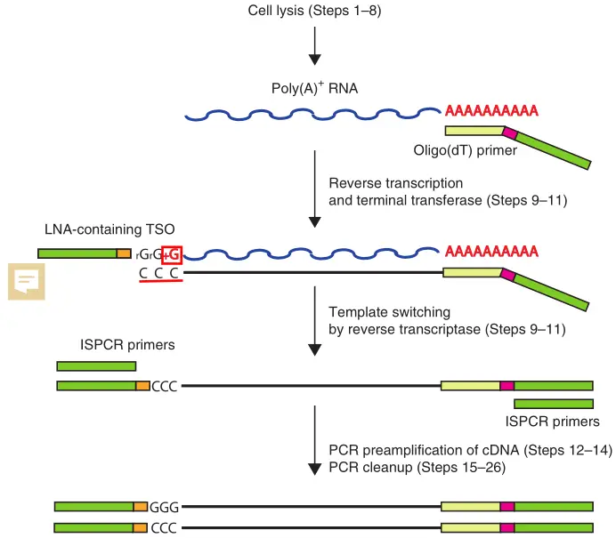
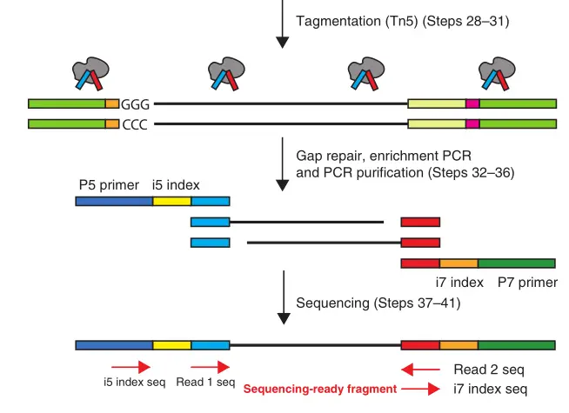
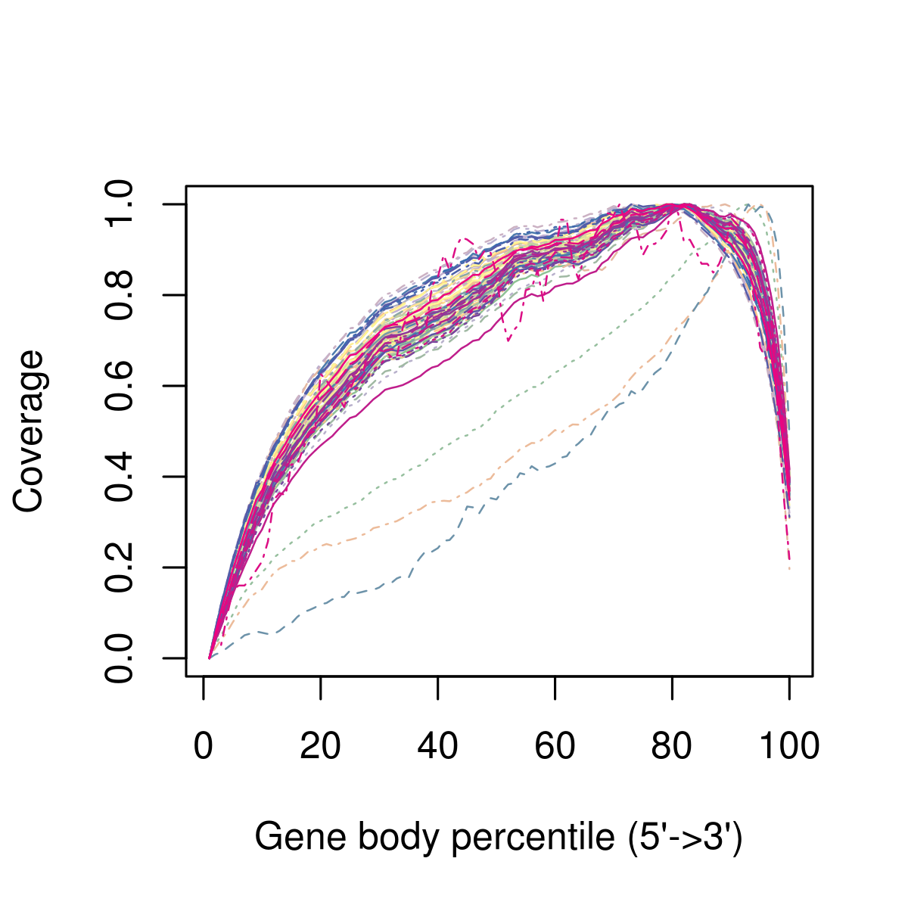
5.2 Quantification of full-length transcripts
There are two types of transcript quantification: full-length and tag-based methods. Full-length quantification methods achieve sequencing coverage of the entire transcript, while tag-based quantification captures only the 5' or 3' end. The choice of quantification method has an important impact on the type of analysis the data can be used for.
The full-length library for scRNA-seq is essentially the same as the bulk RNA-seq method (shown below) and is limited to the plate protocol-based (SMART-seq2). Theoretically, the full-length method can achieve uniform coverage of transcripts, but sometimes there are deviations in the coverage of the whole gene body (as shown below).
Full-length quantitative methods can also detect splice variants, which is difficult to do with other protocols.
Notes:
Pros:
Build library with full-length mRNA, with high coverage of transcripts, able to know the expression of each exon, and even obtain the information of transcript splicing
(Claimed) 50pg RNA starting library
Increased the percentage of mappable reads, as there are fewer empty droplets and no cells as in Drop-seq
Disadvantages:
Non-chain specific. Unable to distinguish between positive and negative chain reads
No early multiplexing (my understanding is that there is no UMI added to the pre-built library so the discrimination ability of individual cells is very low)
Transcript length preference, low library building efficiency for transcripts larger than 4kb
PCR preference for high-abundance transcripts. There is inevitably an abundance preference in the PCR process, and this is an unavoidable "hard" part of many high-throughput sequencing protocols that now use PCR for library amplification.
Potential strand invasion preference. tn5 transposase may prefer more efficient strand invasion for certain characteristics of strands.
Cell sorting using flow cytometry is less efficient and the throughput of cells sequenced in one pass is not high.

Slide 17
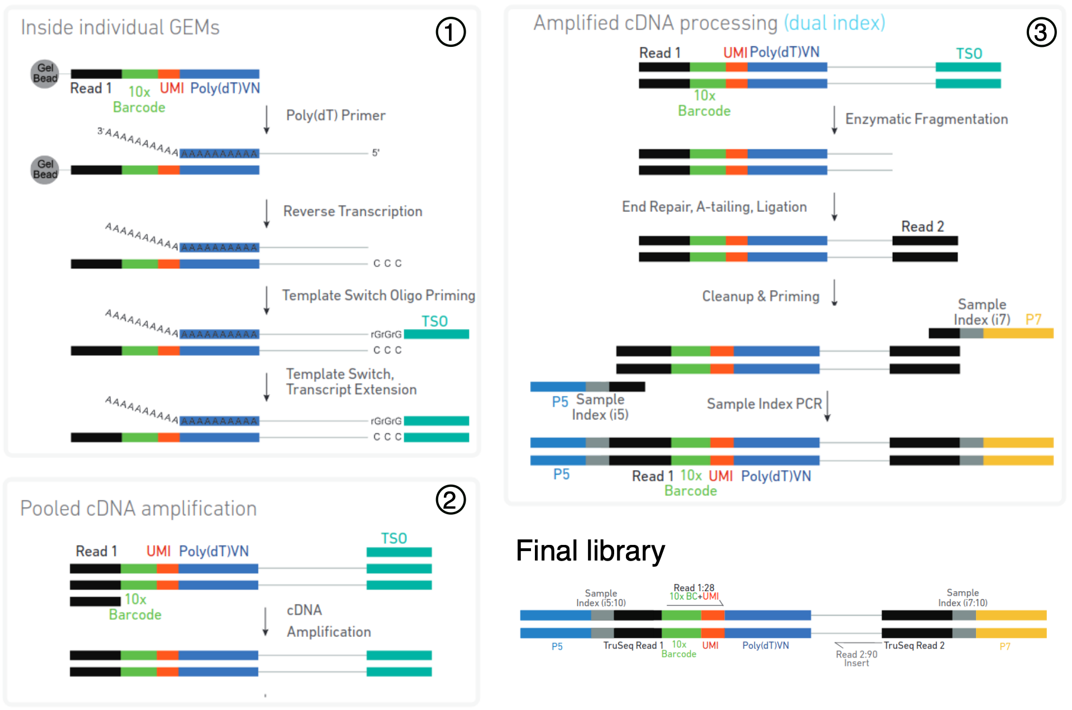
Tag-based transcript quantification
10X Chromium protocol for 3' library building. Cells are captured in individual oil droplets containing one bead (called GEMs). A single bead contains aptamers with a common barcode but with different UMI sequences. A poly(dT) primer is used to reverse transcribe the mRNA with the poly-A tail into cDNA. the GEMs are then broken and the pooled cDNA (from all barcoded cells) is amplified by PCR. Finally, the cDNA is broken and another Illumina junction is attached to the other end of the molecule. The final library consists of a read containing cell-specific barcodes (to identify reads from different cells) and molecular-specific UMIs (to quantify the expression of a gene), while a second read contains sequences from the actual cDNA molecule that can be used to compare it to a reference transcriptome.
The difference between protocols based on 5' and 3' tags is which end of the transcript is sequenced. 3' protocols are more commonly used, although many protocols now allow sequencing from either end (e.g. 10x Chromium supports both ends). the advantage of sequencing the 5' end is that we can obtain information about the transcription start site (TSS) and thus can explore whether there is different TSS use between different cells.
Notes:
https://doi.org/10.1016/j.gpb.2020.02.005

Slide 18
6. Frequently asked questions
The main issues are as follows
Which platform to choose?
How many cells need to be used?
How much sequencing data per cell?
Do I need to set a repeat?

Slide 19
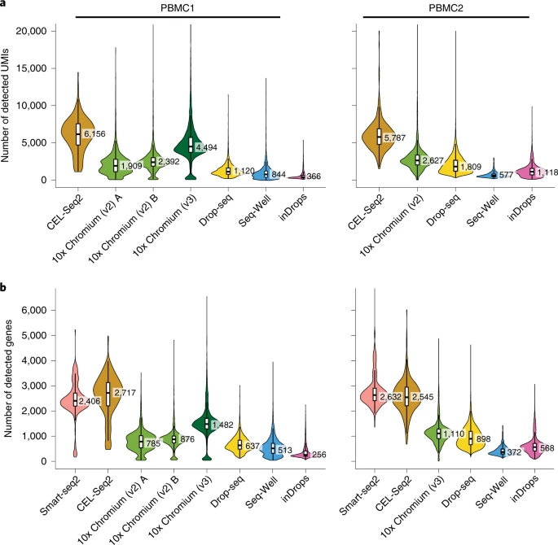
6.1 About the platform
Depends on what kind of biological problem the researcher needs to solve.
If one is interested in characterizing the composition of a heterogeneous tissue, then the droplet-based approach is more appropriate because it can capture a large number of cells (including rare types of cells) in an unbiased manner.
If one is interested in characterizing a specific cell population that has a known surface marker, then it is best to enrich with FACS and then sequence fewer cells at a higher sequencing depth.
If one is interested in studying different isoforms, full-length transcript quantification is more appropriate, which is not possible with tag-based methods.
In contrast, UMIs can only be used with tagging protocols, and they can improve gene quantification.

Slide 20
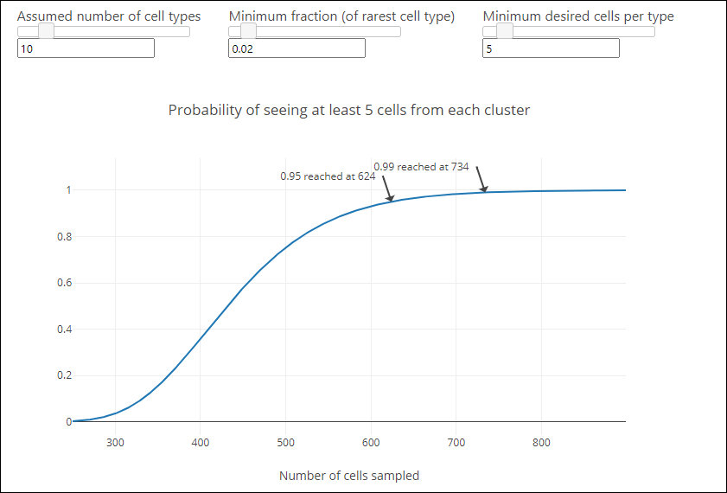
6.2 The issue of cell number
If rare cell types are of interest (no known markers), more cells will need to be sequenced, but the cost of the experiment will also increase.
Typically (for 10X) a cell number of 500-1w per sample is sufficient for an experimental analysis requirements.
There is a tool to assess the number of cells: https://satijalab.org/howmanycells/

Slide 21
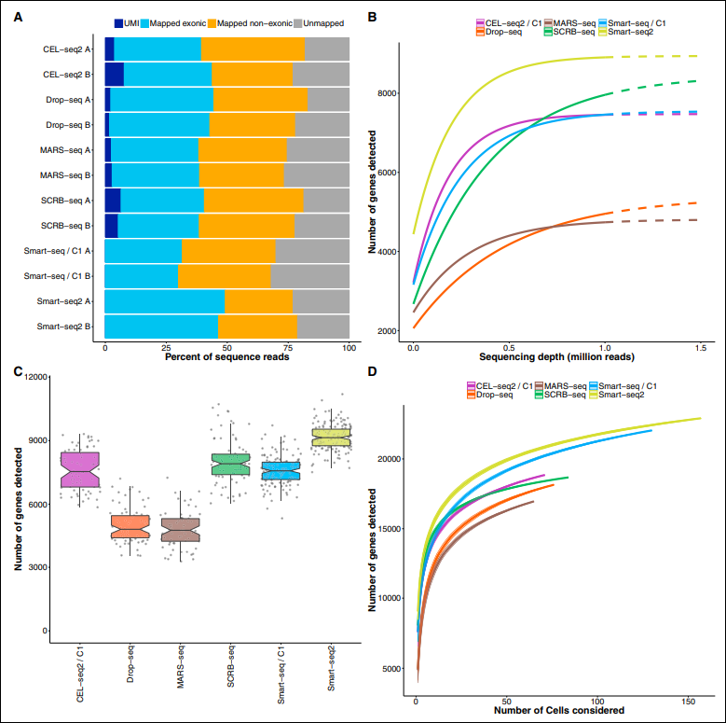
6.3 Sequencing data
At present, cell mapping studies often use the UMI method (drop-seq) with a sequencing depth of about 1 million reads/cell because of the large number of cells (>10,000) to be sequenced. This type of study is mainly for cell classification and marker gene identification, so the information of UMI is sufficient.
For other studies, if you want to obtain more information, it is more appropriate to use the full-length mode of smart-seq2, and it is recommended to sequence at a higher depth so that more biological information such as lncRNA, miRAN and Alternative Splice can be obtained.
Notes:
Comparative Analysis of Single-Cell RNA Sequencing Methods

Slide 22
6.4 Biological Repetition
Due to the presence of genetic and environmental factors, differences between individuals can exist, so the experimental design needs to introduce biological replicates to eliminate that difference. In recent years, single-cell sequencing articles have also become more demanding in terms of biological replicates, for example, human samples, which are highly heterogeneous, are recommended to ensure as many biological replicates as possible for 5 samples per group. And samples from animal models also try to ensure 3 biological replicates per group.

Slide 23
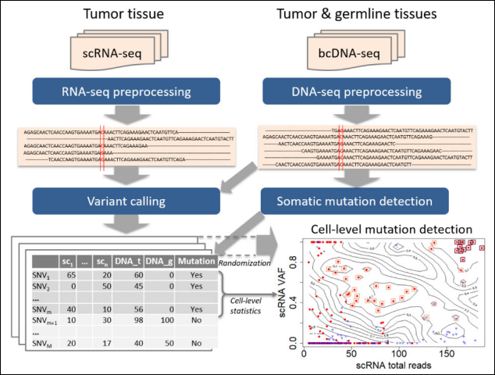
7. SNV analysis based on scRNA-seq data
Both single-cell RNA sequencing (scRNA-seq) and DNA sequencing (scDNA-seq) have been applied to genomic analysis at the cellular level. For mutation analysis, the latter seems to be more common. However, this task is challenging due to the limited input material of only two DNA molecules and the bias and other technical noise associated with whole genome amplification. scRNA-seq has a relatively higher RNA abundance and so generally has better data quality. Various methods exist for detecting mutations from DNA sequencing, but it is unclear whether these methods are applicable to scRNA-seq data.
At higher depths, those peak mutations can be easily detected in the reads of RNA-seq (right panel)
Notes:
Vu TN, Nguyen HN, Calza S, Kalari KR, Wang L, Pawitan Y. Cell-level somatic mutation detection from single-cell RNA sequencing. bioinformatics. 2019 Nov. 1;35(22):4679-4687. doi: 10.1093/bioinformatics/btz288. PMID: 31028395; PMCID: PMC6853710.

Slide 24
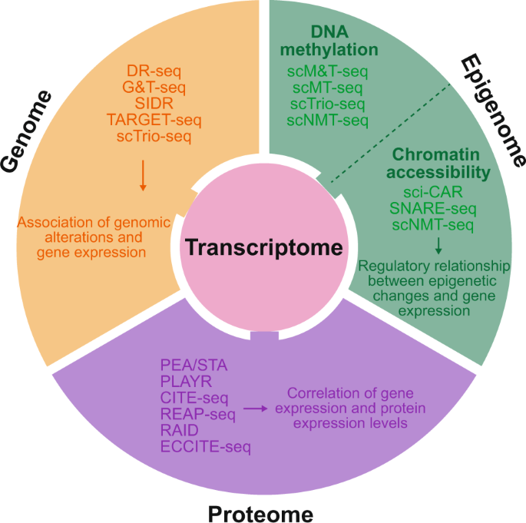
8. Multi-omics study of Single-cell
The core of single-cell multimodal analysis, also known as multimodal analysis, is:
1) Single cell isolation, barcoding and sequencing techniques to measure multiple types of molecules from the same cell;
2) Comprehensive analysis of molecules measured at the single cell level to identify cell types and their functions related to pathophysiological processes based on molecular characteristics.
The main focus is on mRNA-genome, mRNA-DNA methylation, mRNA-chromatin accessibility, and mRNA-protein data.
Expected results include the association between genomic alterations and gene expression, the regulatory relationship between epigenetic changes and gene expression, and the correlation between mRNA and protein expression.
Notes:
Lee, J., Hyeon, D.Y. & Hwang, D. Single-cell multiomics: technologies and data analysis methods. Exp Mol Med 52, 1428-1442 (2020). https://doi.org/10.1038/s12276-020-0420-2

Slide 25
9. scRNA-seq's doublets problem
In scRNA-seq experiments, doubts are artificial libraries generated from two cells. They are usually generated due to errors in cell sorting or capture, especially in droplet-based protocols involving thousands of cells (Zheng et al., 2017).
When we expect to characterize populations at the single-cell level, twins are clearly not available. In particular, twins may be mistaken for intermediate populations or transitional states that do not actually exist. Therefore, it is desirable to identify and remove the diploid pool so that it does not affect the interpretation of the results.
There are several experimental strategies available for removing doubts.
One approach is to use natural genetic variation when pooling cells from multiple donor individuals (Kang et al., 2018). Diploids can be identified as libraries with combinations of alleles that are not present in any single donor.
Another approach is to label a subset of cells (e.g., all cells from a sample) with antibodies conjugated to different oligonucleotides (Stoeckius et al., 2018). After pooling, those libraries observed to have different oligonucleotides are removed.
A more general approach is to infer doublets from expression profiles alone (Dahlin et al., 2018). There are two purely computational methods for detecting doublets from scRNA-seq data. the main difference between these two methods is whether they require cluster information beforehand.
Notes:
http://bioconductor.org/books/3.15/OSCA.advanced/doublet-detection.html

Slide 26
10. Useful materials
https://bioconductor.github.io/BiocWorkshops/index.html
Book: Bioconductor An Introduction to Core Technologies
https://jserizay.com/scRNAseq-workshop/
https://ryanstutorials.net/linuxtutorial/
http://bioconductor.org/books/3.15/OSCA.advanced/doublet-detection.html

